Slide 1
CDISC FHIR Intro
Lloyd McKenzie
August 9, 2019

Slide 2
What is FHIR?
Healthcare interoperability standard
Community
Platform
Opportunity

Slide 3
Complexity Model
Snomed
HL7 V3
openEHR
WS
CDA
Difficulty (log)
XML
HL7 v2
How?
HTTP / HTML
Text
Semantic Depth

Slide 4
FHIR – Key differences
Focus on Implementers
Target support for common scenarios
Leverage cross-industry web technologies
Require human readability as base level of interoperability
Make content freely available
Support multiple paradigms & architectures
Notes:
We don’t actually have a formal manifesto, but these are the principles we adhere to.

Slide 5
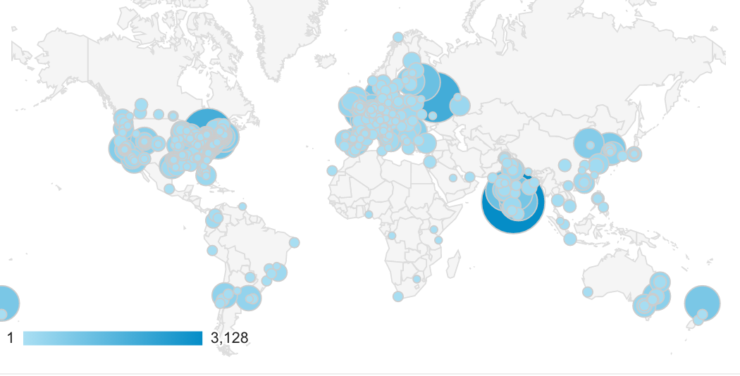

4. Community
Guidance & support
http://chat.fhir.org
Connectathons
Tools
Consensus

Slide 6



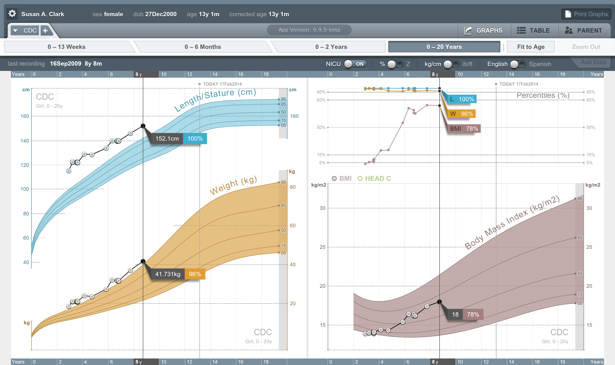


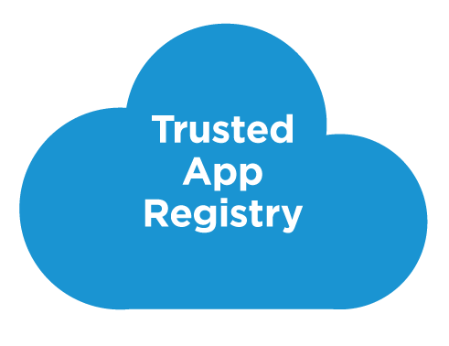



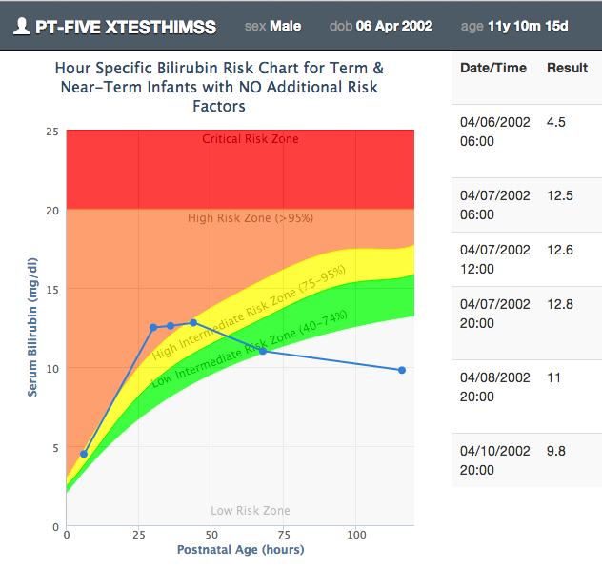

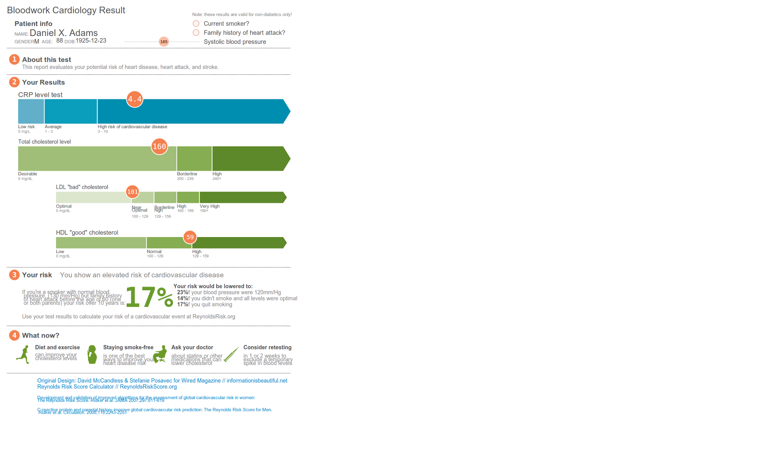





SMART on FHIR
Mobile Apps
Web Apps
OAuth2
REST API
MU-oriented FHIR Data Profiles
Underlying Health IT Systems
Your system here.

Slide 7
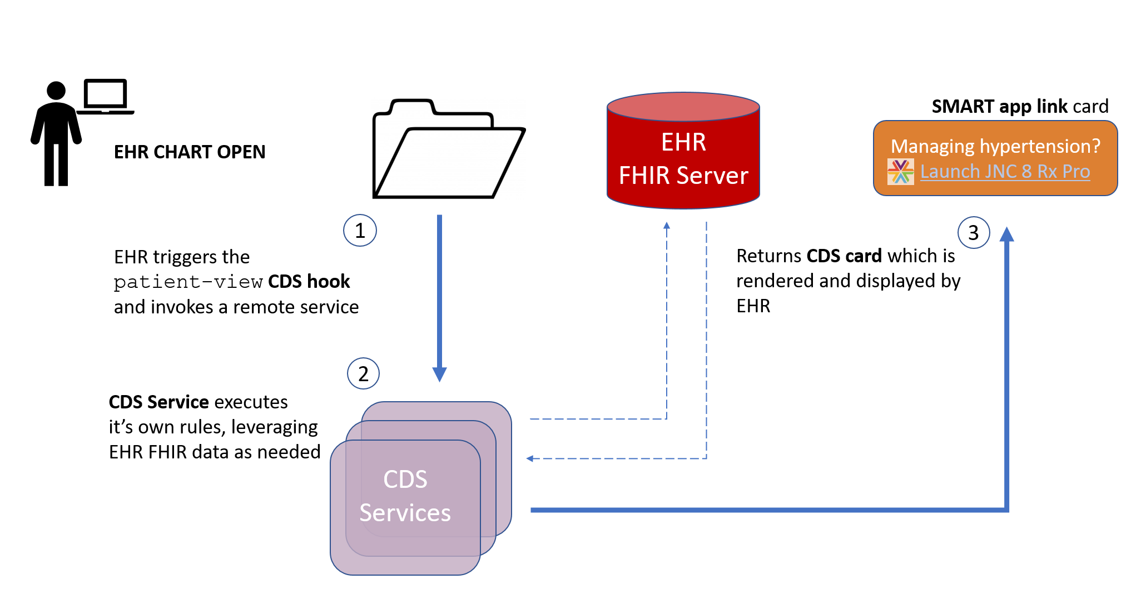
CDS Hooks

Slide 8
Platform for other things
Implementation Guides
Decision support
Google analytics
Test data creation

Slide 9
Opportunities for CDISC
Earlier/easier/higher quality access to clinical data
Bulk data, SMART, query APIs, subscriptions
Can flag data as ‘study relevant’
More easily integrate trial protocols into EHR behaviors
CDS hooks, SMART
Create your own implementation guides based on FHIR?
Others?

Slide 10

Questions?
http://hl7.org/fhir lmckenzie@gevityinc.com

